Slide 1
Lean Principles
U1 – Enterprise Wide Deployment
E1 – World Class Performance
The Learning element ‘World Class Performance’ explains the history, value and principles of Lean and Six Sigma. The coherence and differences to other improvement methods is reviewed as well.
Yellow Belt
Notes:
Welcome to this Lean Six Sigma Academy Yellow Belt training module.

Slide 2

Lean Principles
Principle 1 – Long-term philosophy
Do the right thing for the organization, its employees,
the customer, patients & the society as a whole
This long-term philosophy is the guiding post of the organization in its
continuous quest to offer the best in quality & service to its customers,
employees and society
123RF Stock Photo
Notes:
The focus of Lean is to determine what is of Value to our customer. It is important to realize that every process has a customer, and also that every process is a customer. This means that your suppliers need to find out what makes their product valuable to you as a customer. To be able to find out what the customer defines as value, we need to listen carefully to our customer. Any operation that the customer is willing to pay us for can be defined as being ‘value adding’. From this standpoint, we can start to judge every operation in our company from the perspective of our customers as being ‘value adding’ or not.

Slide 3
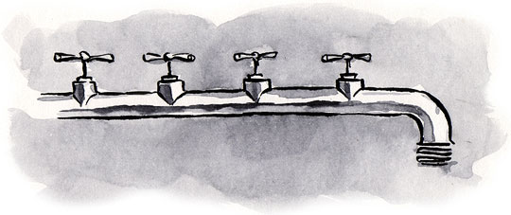
Lean Principles
Principle 2 – Continuous flow
Create a continuous flow to identify problems
Look at the process as a whole instead of focussing on separate activities
All phases of the process are interdependent
Streamline company processes
Everything focuses on the operational process and patient value
Patient value
Notes:
Flow is created by taking a different view of our processes. Instead of focusing on each separate activity; we need to look at the whole process. To streamline our operations, we need to remove intermediate inventories or ‘buffers’ between operations. We also need good reliability and operations with predictable outcomes. Flow means that the different phases of our operations become interdependent on each other. To make this possible, there should be a focus on the operational activities and patient value.

Slide 4

Lean Principles
Define what is of value to the patient
Focus on the patient and customer
Every process has a customer
Every process is a customer
Determine what ‘value’ means to the customer or patient
Listen to the customer/ patient
What will the customer/ patient pay for?
What will the customer/ patient NOT pay for?
Measure every activity to the ‘patient/ customer value’
123RF Stock Photo
Notes:
Once you have defined what the value increasing operations are within your organization , there are two ways to increase value in your product or service. The first is to do things right the first time. This means that you prevent making mistakes as much as you can. Also, this means that if a mistake happens, you take care not to pass on the mistake to the customer or patient. To start with, it is important that you don’t receive mistakes from your suppliers. The second way to increase value in your product is to eliminate waste in your operations..

Slide 5

Lean Principles
The Three M’s
Muda: Non-Value Added
Activities that don’t add value to the process
The eight types of ‘Waste’ that cause extra waiting time, movement, stock, etc.
Muri: Overburdening staff or equipment
Pushing machines or staff beyond their natural limits
Results in safety & quality problems and/or breakdowns & defects
Muri can be avoided through standardized work
Mura: Unevenness
Results from an irregular schedule or fluctuating patient volume due to internal problems such as downtime/missing equipment or errors
Mura can be avoided by levelling out the work schedule: Heijunka
123RF Stock Photo
Notes:
Besides discovering waste or MUDA in everything we do, there are two other types of problems that we have to solve when striving for perfection. MURI is the problem of trying to push the equipment or people beyond their natural limits. This will eventually lead to problems with quality, safety and breakdowns. One way of fighting MURI is to introduce standardized work and to provide training for the staff. MURA or ‘unevenness’ is the second difficulty that can cause serious problems, leading to breakdowns and quality issues. We can remove MURA, by levelling out the workload over the different operations and by removing bottlenecks.

Slide 6








Lean Principles
The eight types of waste
Transporting
Inventory
Movement
Waiting
Over-production
Over-processing
Defects
Under utilisation of staff
Documents/ moving patients between treatments
Large packaging medicines/ to many patients between process steps
Searching, unnecessary movements
Waiting on diagnostic results/ on treatment/ for beds
Too many reports, too much medication
Taking unneeded steps to process documents/ asking questions again/ blood samples repeated
Incorrect or incomplete data input. Protocols incorrect
No use of knowledge from workforce. Not sharing
information as needed/ expertise
Notes:
Here we see eight types of waste in services, in Japanese this is called MUDA. Every one of these types of waste are not in the interest of the customer and in general, the customer or patient is not willing to pay you for executing these operations. In most companies you will still find a lot of these types of waste occurring frequently; probably even more then value adding operations. This means that there are a lot of opportunities to remove this waste and therefore many opportunities to reduce unnecessary costs. The eighth type of waste is a special type, which recognizes that by not using the available knowledge we are essentially trying to reinvent the wheel.
6

Slide 7
Lean Principles
Principle 3 – Pull Principle: customer/ patient pulls first
Medications in one bin with Medications in two bin with FIFO
NO method of organization (first in first out) organization
Notes:
To prevent inventory waste, the leading operational principle should be ‘Pull’. This means that we should produce only when there is demand from our customer. This also means that we should not produce more than our customer needs at the given time. To be able to do this, there are a few essential conditions that must exist such as good cooperation, communication and alignment of the supply chain. In addition, rapid changeovers between products and a flexible workforce are important as well. In this picture, we can see the flow of pull of information of first in , first out

Slide 8
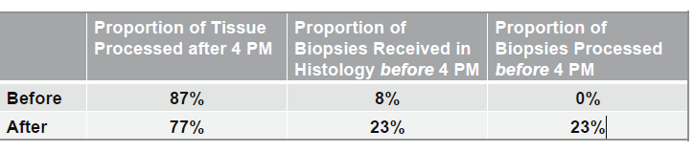
Lean Principles
Principle 4 – Heijunka: levelling out the work schedule
Achieving Heijunka is fundamental to eliminate Mura, which is fundamental to eliminate Muri and Muda
Example: processing pathology results in a lab is over target cycle time
Courier’s deliver samples from doctors labs all over the city mostly arriving in the evening
Level loading implemented: couriers deliver earlier in day not just in evenings
Processing of results starts earlier and procedures that take time carried out in one block
Notes:
Heijunka is levelling the work schedule achieving balance

Slide 9
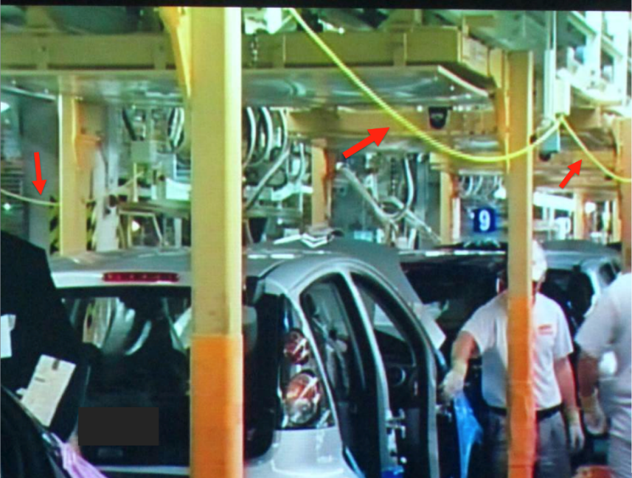
Lean Principles
Principle 5 – Jidoka/ Autonomation
Jidoka provides equipment and staff the ability to detect when an abnormal condition has occurred and immediately stops processes
This enables processes or procedures to build-in quality at each process step instead of inspecting at the end of the process/procedure
Every staff member has the permission to stop when a quality problem occurs
Notes:
Jidoka is employee empowerment to make quality decisions

Slide 10
Lean Principles
Principle 6 – Standard operating procedure or protocol
Standardised tasks and processes are the foundation for continuous improvement and employee empowerment
There are many ways to do something. There is only one optimum way. Define this way and make it the standard for everybody!
If someone determines a better way, this will become the new standard
It is impossible to improve a process until it is stabilized and standardized
Notes:
All processes and procedures should be standardised –everybody can carry out the process the right way

Slide 11
Lean Principles
Principle 7 – Visual management
Organised work environment (5S programs, labelling)
Visualisation of objectives and Key Performance Indicators (plan boards)
Standardised work instructions
Amount of work in process (Kanban)
Autonomous maintenance
Use of Poka Yoke to prevent mistakes
No organised method to store IV- bags. Quantity on hand doesn’t match usage
Organised storage method
Inventory based on usage
Notes:
Visual Management is important to make a workplace look organised and in control

Slide 12
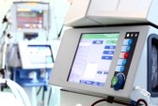
Lean Principles
Principle 8 – Reliable technology
Supporting procedure & process
New technology should support people, the process and the organisation as a value stream
New technology must be tested and proven before use
Reliable products
Maintenance
Notes:
Technology is an important aid to support processes and procedures as well as people

Slide 13
Lean Principles
Principle 9 – Grow Leaders
Grow leaders who thoroughly understand the work, live the philosophy, and teach it to others
Good leaders know how to get their hands dirty (go to the Gemba or source)
Good leaders understand the daily work (worked their way up)
Good leaders follow the long term organisation philosophy
Notes:
Good leaders are important but it is important that they understand the work and can teach others

Slide 14

Lean Principles
Principle 10 – Employee development
Develop exceptional people and teams who follow the company's philosophy
Respect
Respect employees
Safety is the number one priority
Team work
Use multidisciplinary teams
Involve hands on staff in early phases of process development
Continuous improvement
Staff drive continuous improvement (bottom up)
Management should continuously challenge staff (top down: facilitation)
123RF Stock Photo
Notes:
Employees drive an organisations culture through respect, team work and continuous improvement.

Slide 15
Lean Principles
Principle 11 – Supplier Development
Respect your extended network of partners and suppliers by challenging them and helping them to improve supplier development
An organisation cannot eliminate all waste, its suppliers must also eliminate waste!
Treat partners as an extension of your own organisation
Find solid partners and grow together to mutually benefit in the long term
Challenge partners to grow and develop
Set challenging targets and assist in meeting them
Notes:
Suppliers should be developed and treated as partners

Slide 16
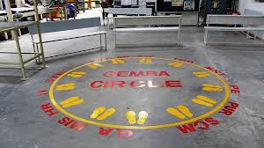
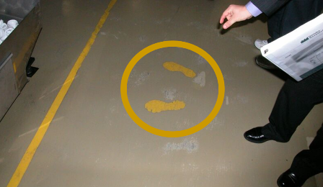
Lean Principles
Principle 12 – Go to the Gemba
Go to the source to observe and verify data
Don’t theorize on the basis of what people and computers tell you
Every high-level manager should spend at least 30 min/day on the floor
Every activity is subordinate to the operational process
Notes:
All employees should study the process or activities within an organisation to gain a better understanding of how things actually work

Slide 17

Lean Principles
Principle 13 – Nemawashi
Make decisions slowly by consensus, thoroughly considering all options and implement decisions rapidly (Nemawashi)
Consent for proposed changes
Slowly lay the foundation
Talk to the people concerned
Gather feedback and support
123RF Stock Photo
Notes:
Consensus or Newawashi is important in decision making to ensure decisions are made in a correct manner

Slide 18
Lean Principles
Principle 14 – Learning Organisation
Become a learning organization through relentless reflection (Hansei) and continuous improvement (Kaizen)
The manager takes the blame in public and the department works on solving the problem
Hansei is seen as a learning process - one gets better and stronger
Notes:
Reflection and continuous improvement are important elements of a learning organisation

Slide 19
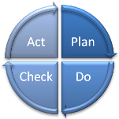
Lean Principles
Continuous improvement – Kaizen
Sustain what has been achieved!
Today let’s do something better than yesterday
Turn every employee into a quality inspector
‘Click’
Improve: 8D / PDCA / DMAIC
Opportunity
for improvement
Sustain
Continuous improvement of (development) processes / systems / procedures
Notes:
Kaizen is a valuable tool for continuous improvement for processes and procedures

Slide 20

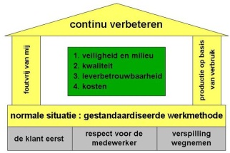

Lean Principles
Common Vision We all want the same
Principles Same set of rules for everyone
Tools The correct instruments
Execution Cooperation & discipline
Notes:
A coomon vision, procedures, tools and execution are all principles of a lean system.

Slide 21
Lean Principles
Lean Principles
Value: define what is of value to the patient
Value Stream: identify the value stream/ eliminate waste
Flow: create a constant flow
Pull: produce based on demand
Perfection: continuous improvement
2.
Map the Value Stream
3.
Create Flow
4.
Establish Pull
5.
Seek Perfection
1.
Identify Value
Notes:
Lean organsiations follow a set of principles which they are contatly evaluating

Slide 22
Lean Principles
If an organization is not Lean…
Problems are hidden in a ‘sea of resources’
By eliminating problems (rocks) we become Lean
WORK IN PROGRESS
Long
Set-Up
Time
Poor
Quality
Lack of
Training
Poor
Scheduling
Equipment
Down-Time
Notes:
Hidden costs are not immediately obvious in a process by eliminating these hidden costs or rocks we become Lean

Slide 23
Lean Principles
When implementing Lean…
The water level needs to drop to shorten lead-time
Problems are exposed by ‘lowering the water level’
By eliminating problems (rocks) we become Lean
Long
Set-Up
Time
WIP
Poor
Quality
Poor
Scheduling
Equipment
Down-Time
Lack of
Training
Notes:
By exposing and analysing problems (rocks) we become lean

Slide 24
Introduction Lean Six Sigma
DfSS
Where to start
5 – Robustness
Robust processes
Design for Six Sigma
Quality Function Deployment
6 Sigma
4 – Capability
Reducing variation
Process control
Statistical tools
Lean
3 – Stability
Stable processes
Eliminating Waste
Flow & Pull
Kaizen
2 – Overview & Insight
Visual Management KPI’s
WIP control
Continuous improvement culture
DfSS
5S
Six Sigma
1 – Structure
Work environment
Procedures & instructions
Abnormalities visible
Lean
Kaizen
Notes:
There is a roadmap of tools useful for Lean deployment starting with 5S and working up to designing products and services

